Slide 1
Grave Words
A Grave History Where Words Matter

Slide 2
Problem: How can we use data to generate interest in what the Nashville City Cemetery offers?
Nashville City Cemetery aims for a equitable and fair environment for all Nashvillians. This African-American history month, every Saturday we will sponsor tours talking about the African Americans found on the lot, along with some insights on what we can learn about their lives during this historical period.
In particular, we will be examining the relationship that language has to culture, how they shape each other, and how attitudes about slavery changed over the course of the Civil War. We will teach our target audience, older children and their families, the power that words told and how to use them with respect.

Slide 3
Each and Every Headstone, a Story
For nearly two centuries, Nashville City Cemetery has been a final resting place for generations of Nashvillians from all walks of life - among the deceased is Elias Polk, freed slave turned politician after his emancipation in addition to the man who owned him, president James K. Polk (although he was moved later).
This African American History month, we propose a new kind of tour - one that listens carefully to the language etched in stone, giving new life to often nameless voices so often drowned out by more famous historical figures at the park.

Slide 4
Goal: Build empathy, teaching older children the relationship between language and culture, and how the words they choose when interacting with the world around them matters
I conducted an analysis of language usage by reviewing “Remarks” on tombstone logs and inscriptions where over 2000 Black Americans saw their final resting place from 1846-1891.
By grouping the “Remarks” into three categories, “Free”, “Slave”, and “Servant”, I tracked how references and labelling practices for enslaved or free members of the Black community changed, often in drastic swings, throughout the 19th century.
Language is not neutral. Anyone who has been the victim of hateful words knows this. Words like “Free” represent a reclaimed humanity, powerful markers of identity and dignity.

Slide 5
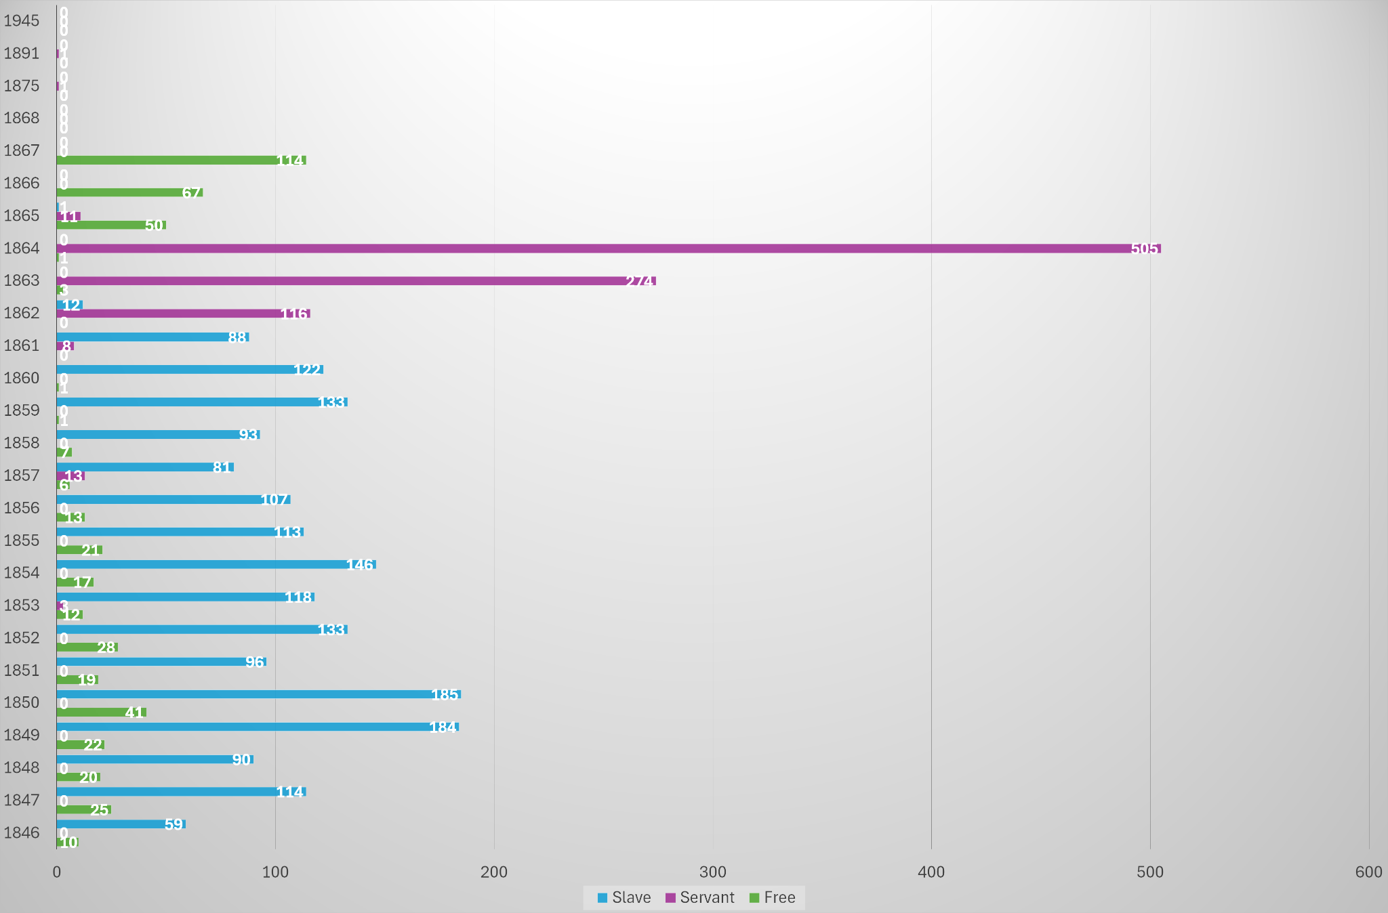

Slide 6
There is an extreme upward trend toward using “Servant” as a Remark in the year 1862 that continues until 1864. At the same time, there was an extreme downward trend towards using the Remark “Slave”. Interestingly, 1862 is just 1 year after the start of the Civil War. Before 1861, primarily the share of Remarks is a majority “Slave” with some “Free”.
In 1864, we see the largest jump of the usage “Servant”, while simultaneously seeing 0 instances of “Slave” and only 3 instances of “Free”. This seems to imply that while “Servants” were not free yet, slave-owners seemed to be eager to separate themselves from the “Slave” label. This indicates a dramatic, possibly abolition-leaning cultural shift that started the year prior in 1862 - by no coincidence, the Emancipation Proclamation was just the year before in 1863. Another possibility was the rising tide of conspiracy theories around “Slavocracy”, popularized by abolitionists like Frederick Douglass - the basic idea was that slave-owners had the power to control the government with their capital, and intended to do so. It's possible this anti-slavery rhetoric may have played a part in is what is clearly a change of pace for Nashville's culture at the time. Meaningfully, these theories assume that slave-owners were the ones burying the individuals in the data.
It is also of interest that the Remark “Free” is not also present among “Servant”, and “Free” follows its own unique trend, with an interesting spike in 1850, the same year as the Fugitive Slave Act, which mandated former slaves be returned to their owners, even if they were free. This, possibly, could explain the spike in “Free” remarks.

Slide 7
After 1862, the Remark “Slave” is not seen at all except for 1 single instance; an unnamed infant slave who died January 2nd, 1865 - less than 1 month before Tennessee ratified an amendment outlawing slavery in the state on February 22nd, 1865.
By no coincidence, we see a rise in the use “Free” in the year 1865, rising and ending in 1868, where it is not used again until the dataset ends at 1945, indicating it was considered a redundancy at the time.
Interestly, there are two separate instances of “Servant” for the last time in the years 1875 and 1891. This was early Jim Crow era of Tennessee, so racist naming conventions were probably the norm.

Slide 8
Why This Matters
With this campaign, we can turn passive memorials into active learning sites, showing the public that there’s more to history than just dates and people who did important things - history is made by all people, and so often, the ones who go unremembered.
We can offer African American families and educators a space to reflect and honor their great heritage. For the public at large, this is time to connect with the idea that language in a culture has the power to both wound and heal.

Slide 9
Marketing details:
Guided Tours: Feature selected headstones that articulate this linguistic evolution
Digital Companion: With the Nashville City Cemetery app, we can have an interactive map with data overlays and historical context
Media Hook: Invite local professors of African American History and/or Linguistics to speak on the subject for press attention
Two-pronged approach: Digital and print media will seek to build engagement (metrics are sign-ups for event) through social media and print

Slide 10
Conclusion
This isn’t just a campaign to “raise foot traffic”. Getting this information out to the public is an honor and a responsibility as we celebrate the great achievements and history of the Black community this February.
At Nashville City Cemetery, let’s be a place where we don’t hide from the painful truths of our past, but rather, we show the public that words truly matter - starting with ours.

